Slide 1
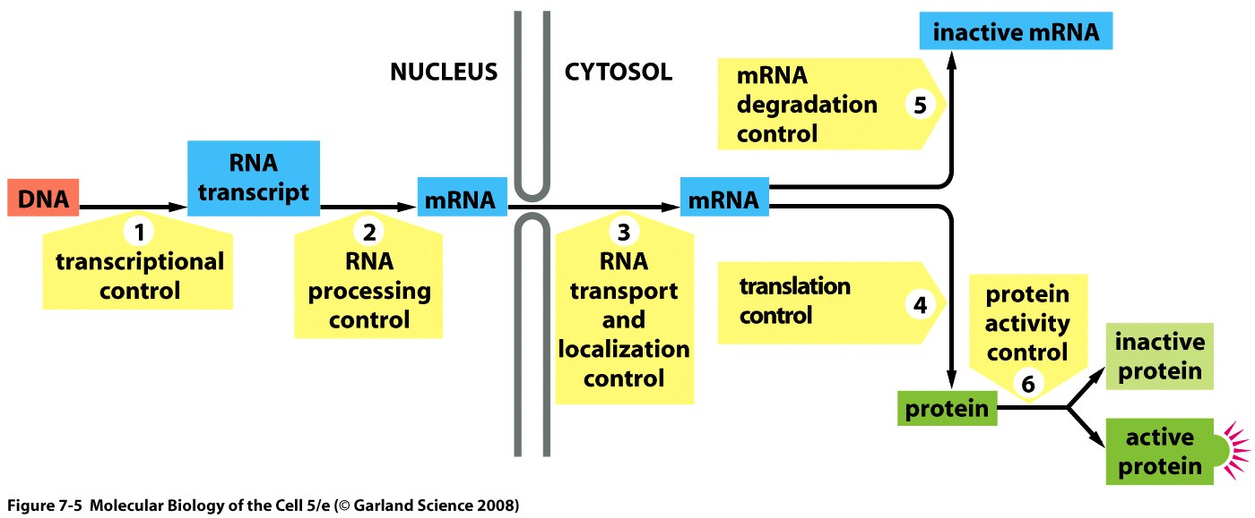
Regulatory RNAs

Slide 2
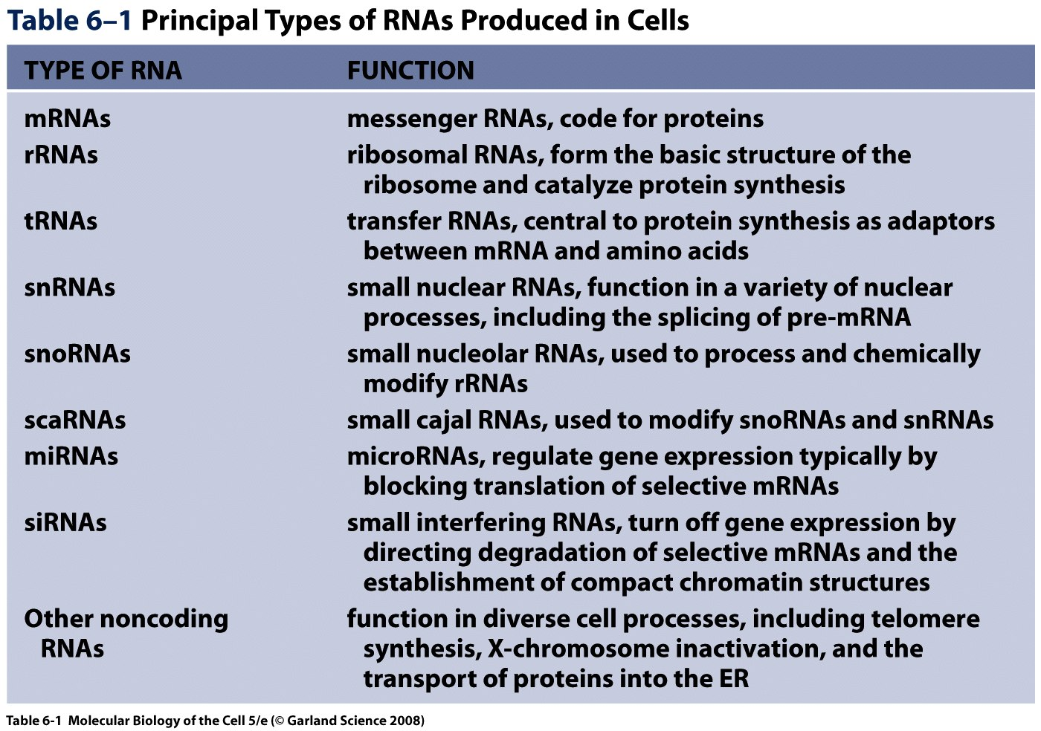
Cells produce several types of RNA

Slide 3
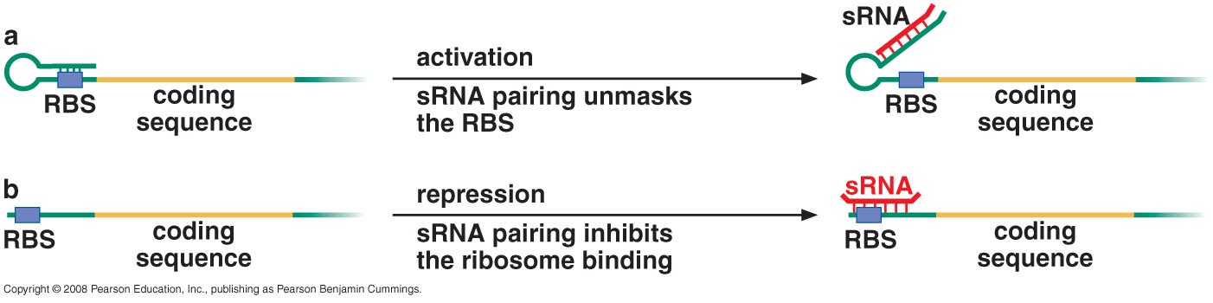
REGULATION BY RNAs IN BACTERIA
Activation and repression of translation by sRNAs (bacterial small RNAs)

Slide 4
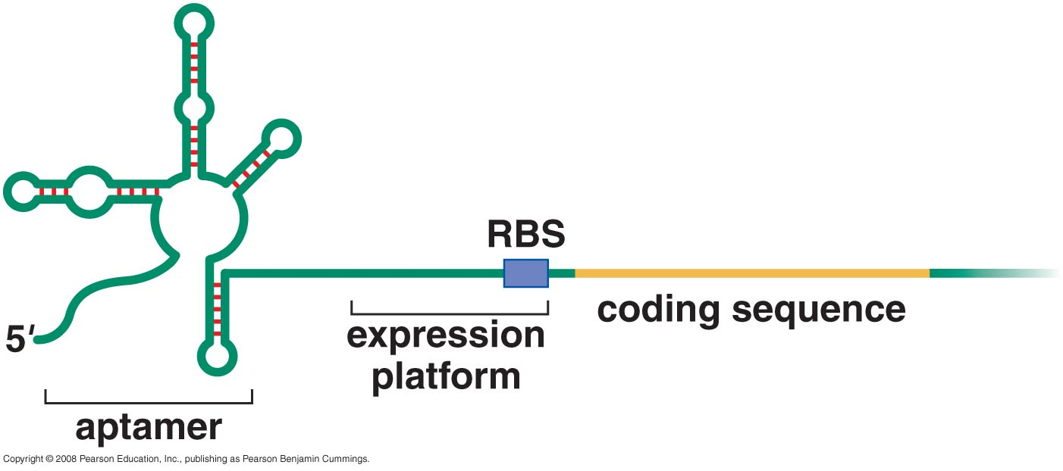
Riboswitches reside within the transcripts of genes whose expression they control through changes in secondary structure
Organization of riboswitch RNAs

Slide 5
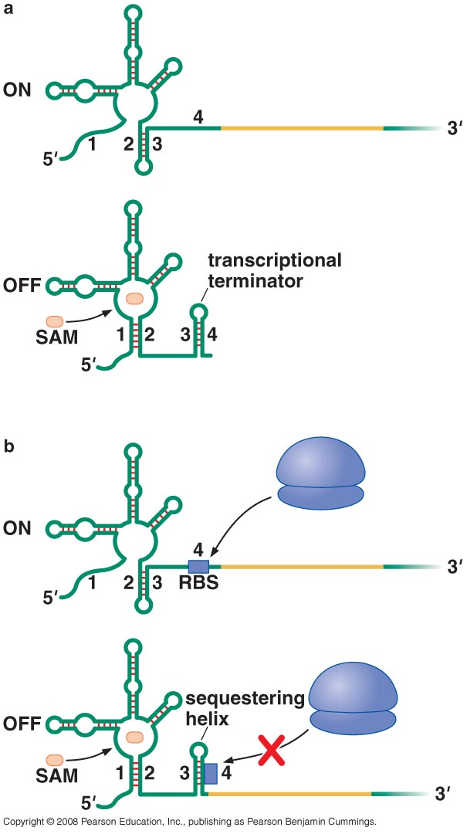
The aptamer binds small molecules -> conformation changes
-> conformation changes of expression platform -> termination of transcription or inhibition of translation initiation
Two examples of a SAM
(S-Adenosylmethionine)
sensing riboswitch

Slide 6
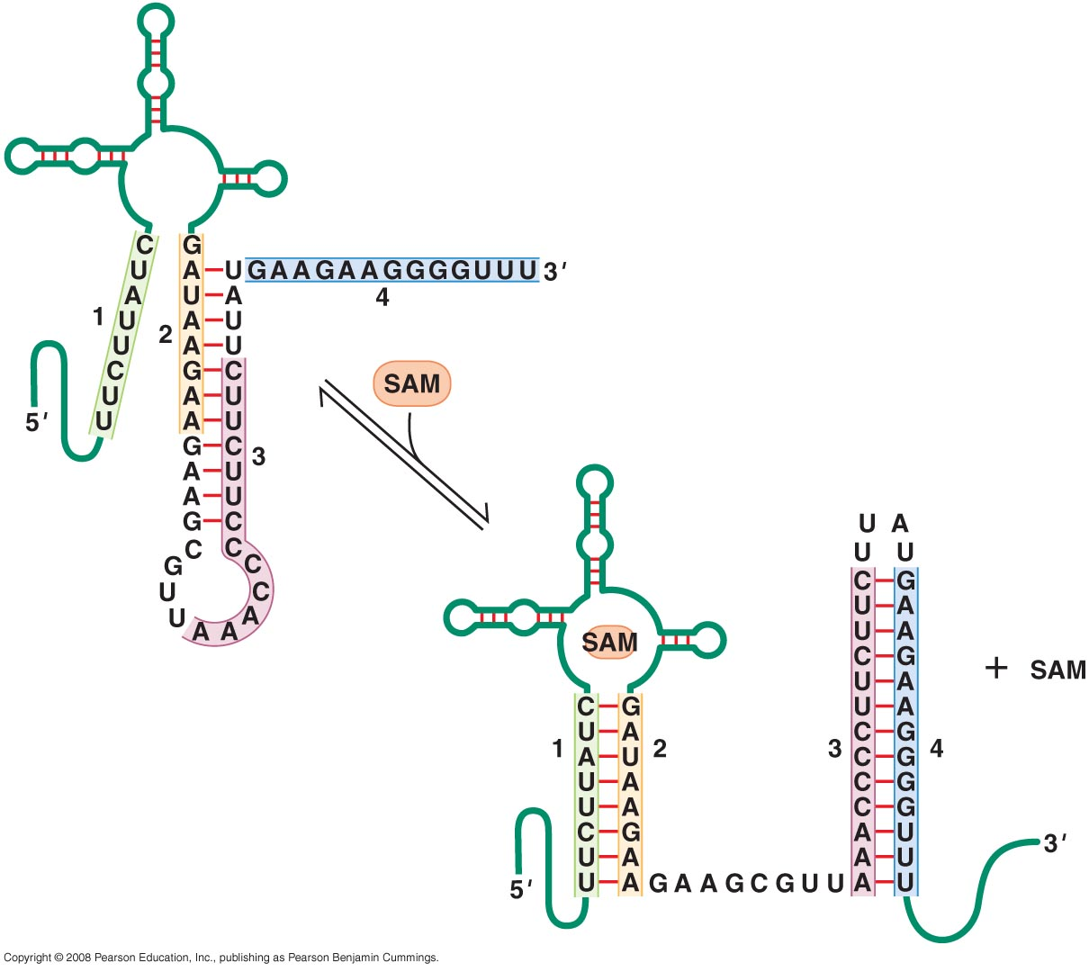
Changes in secondary structure of a SAM-sensing riboswitch

Slide 7
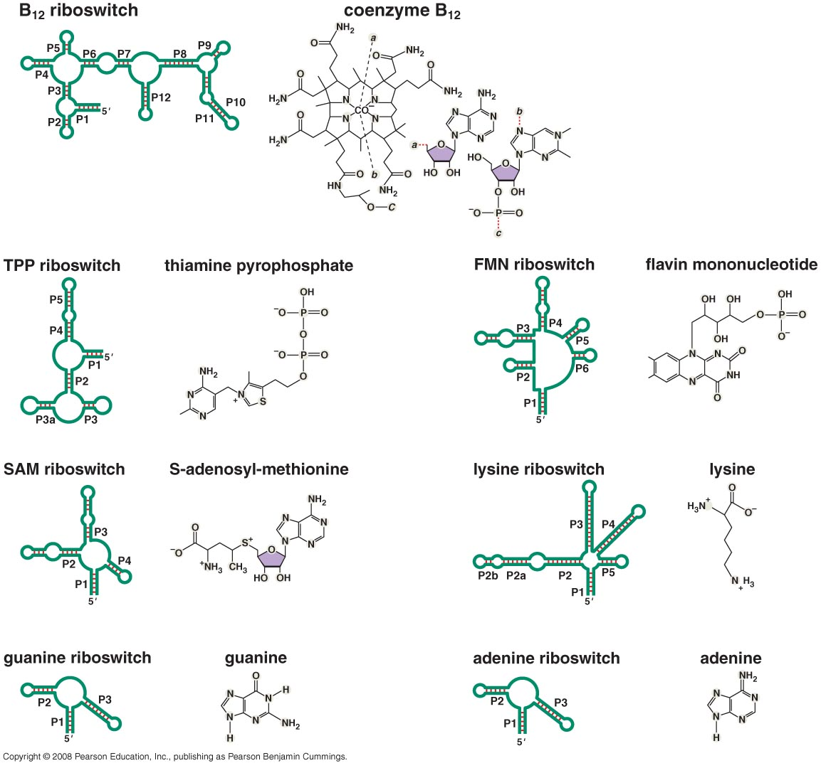
Riboswitches respond to a range of metabolites

Slide 8
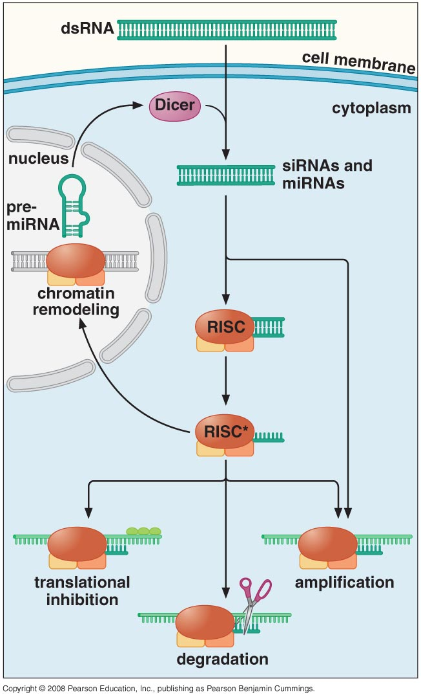
RNA INTERFERENCE IS A MAJOR REGULATORY MECHANISM IN EUKARYOTES
Short RNAs that silence genes are produced from a variety of sources and direct the silencing of genes in three different ways
RNA interference (RNA i)
Small interfering RNAs (siRNAs)
microRNAs (miRNAs)
RNA Inducing Silencing Complex (RISC)

Slide 9
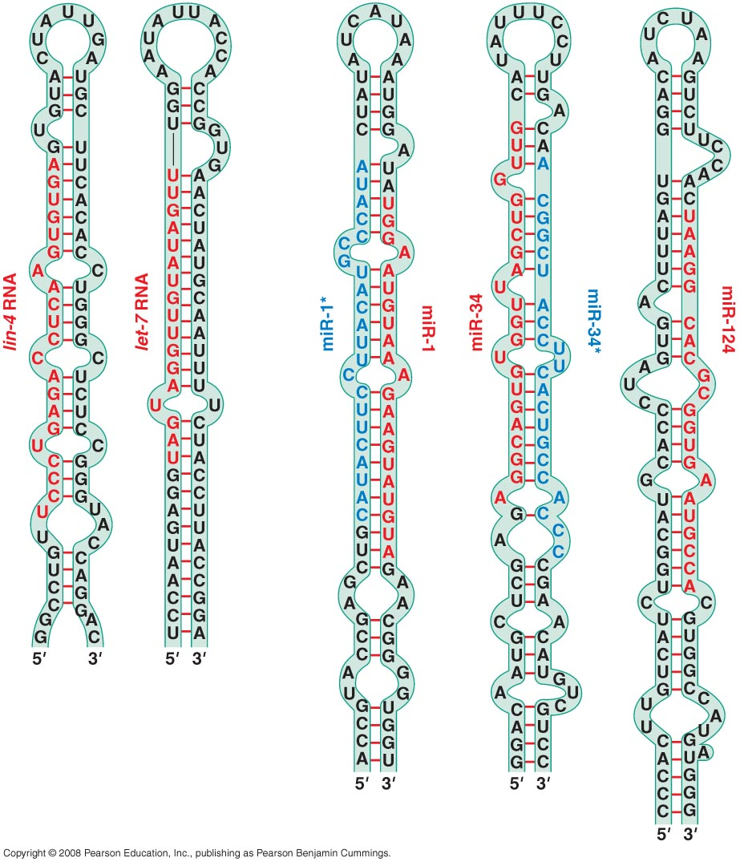
SYNTHESIS AND FUNCTION OF mi RNA MOLECULES
mi RNAs have a characteristic structure that assists in identifying them and their target genes
Structure of some pre-miRNAs prior to processing to generate the mature miRNAs

Slide 10
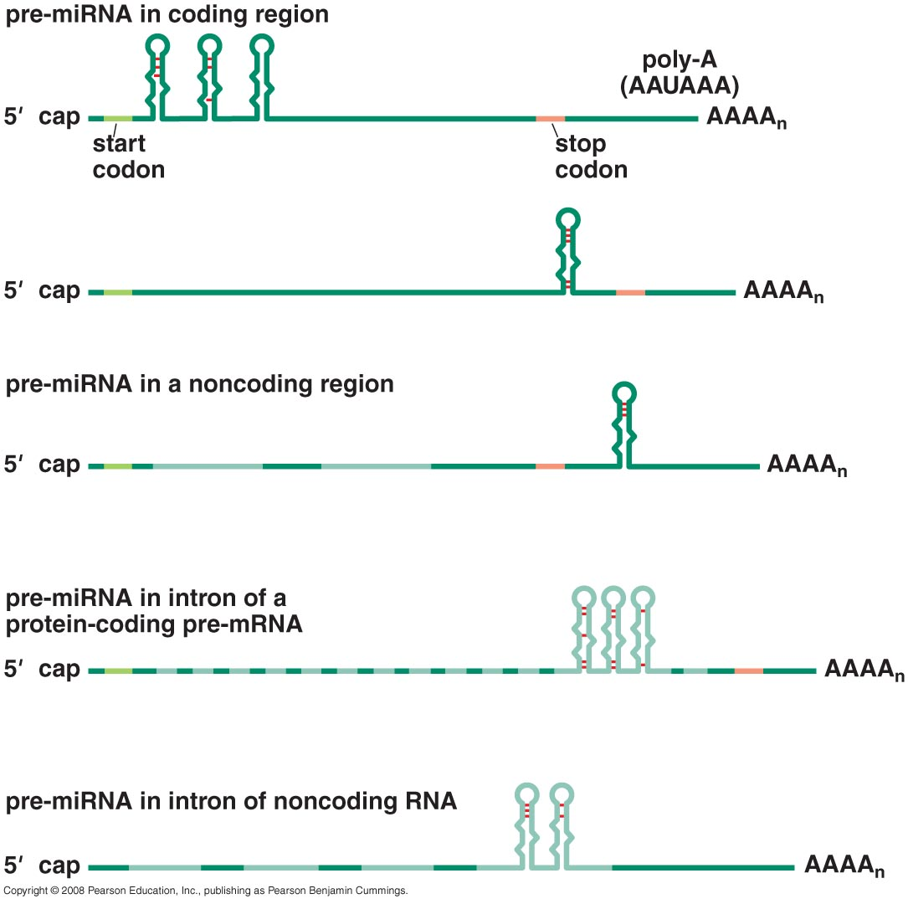
miRNAs are coded in both introns and exons in RNA

Slide 11
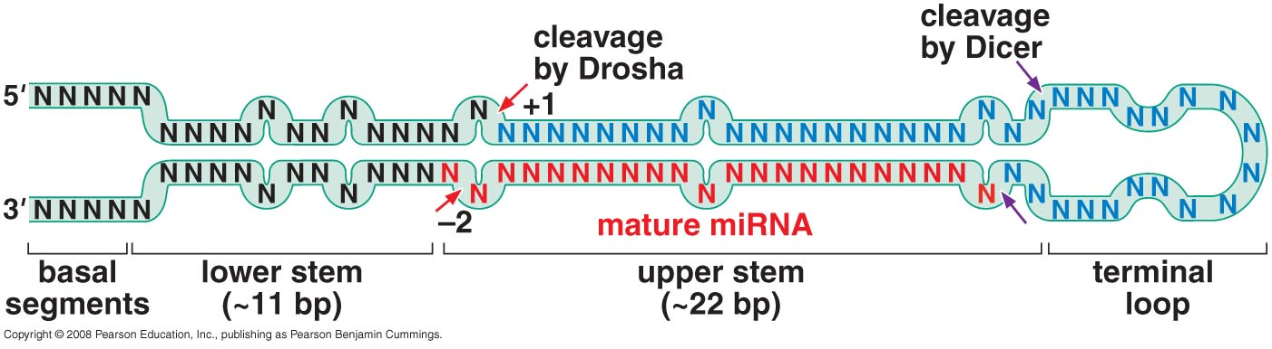
An active miRNA is generated through a two-step nucleolytic processing

Slide 12
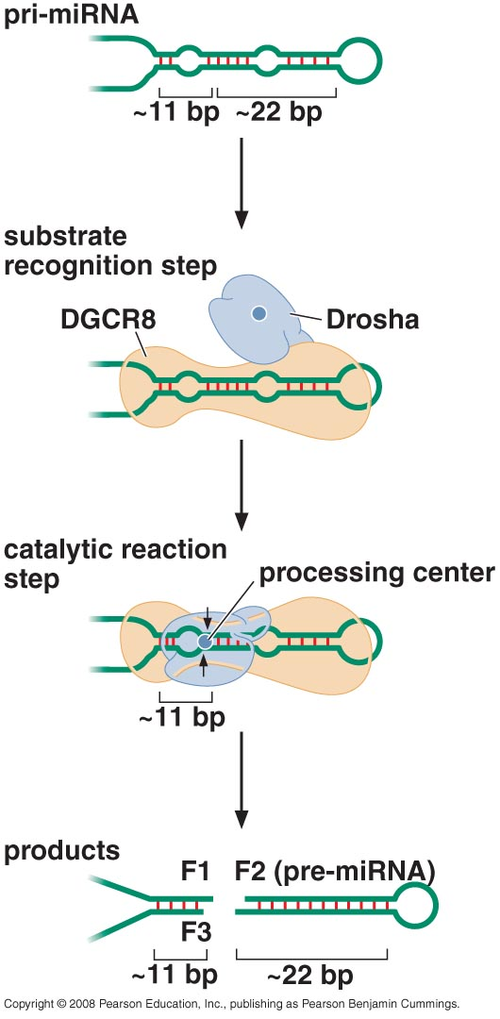
Recognition and cleavage of pri-miRNA

Slide 13
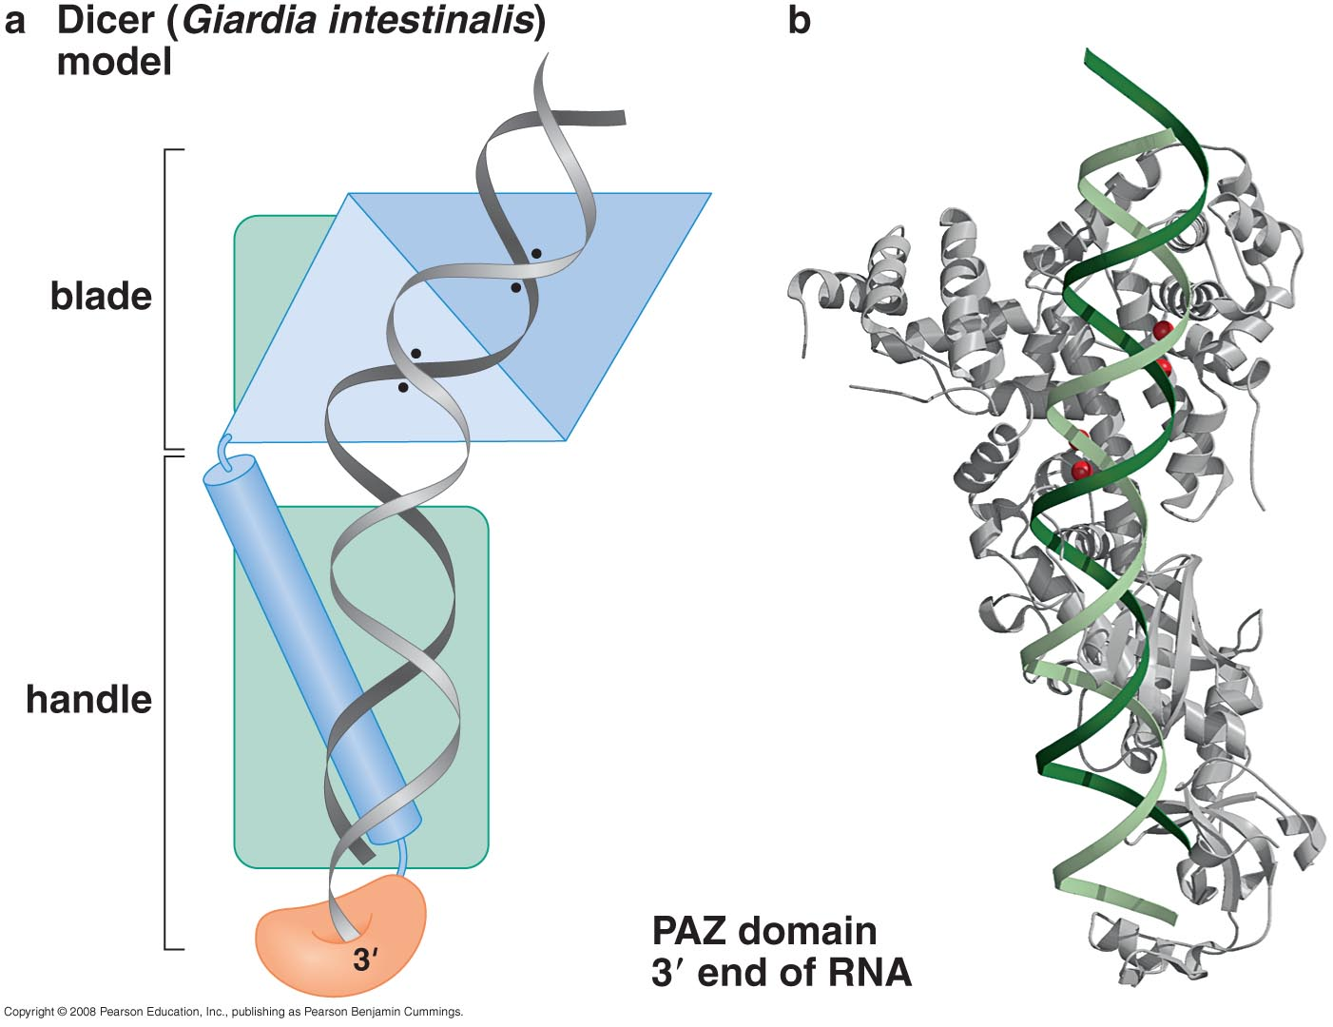
Dicer is the second RNA-cleavage enzyme involved in miRNA production

Slide 14
Incorporation of a guide strand RNA into RISC makes the mature complex that is ready to silence gene expression

Slide 15
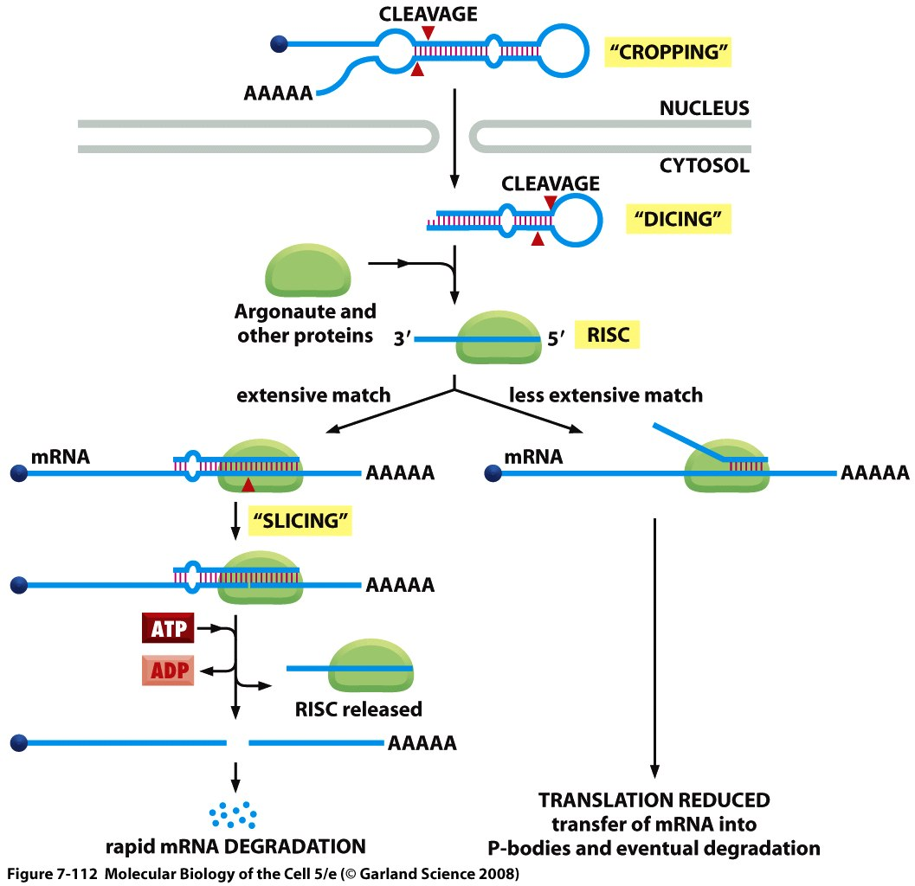
Mature RISC

Slide 16
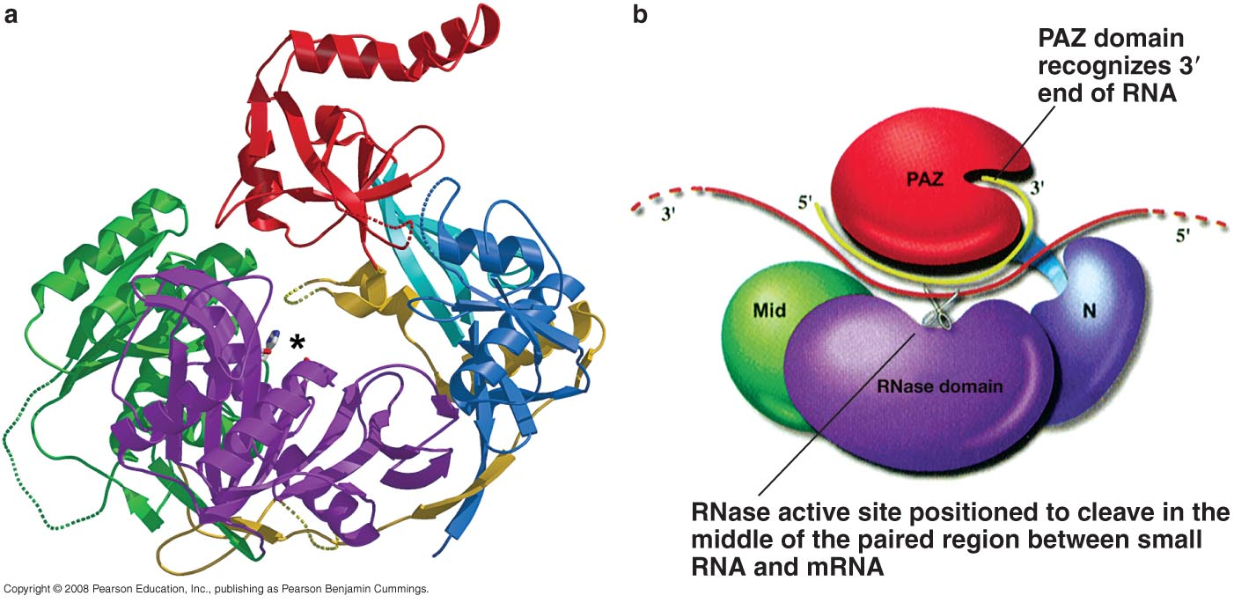
Argonaute structure, showing RNA binding and RNase domain

Slide 17
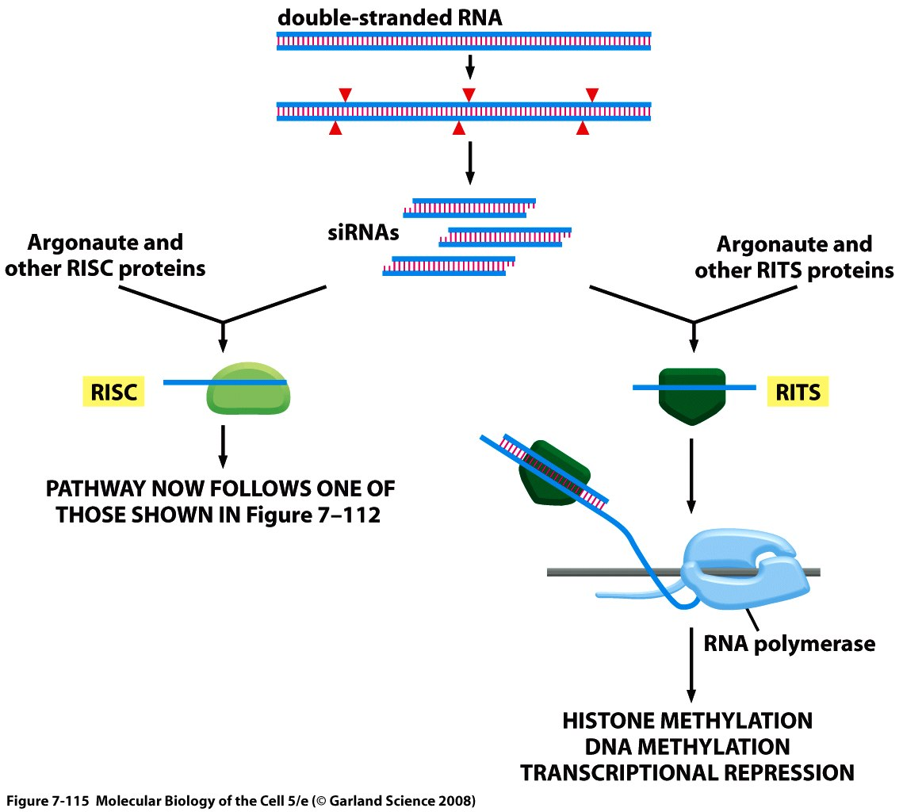
Si RNAs are regulatory RNAs generated from long double-stranded RNAs

Slide 18
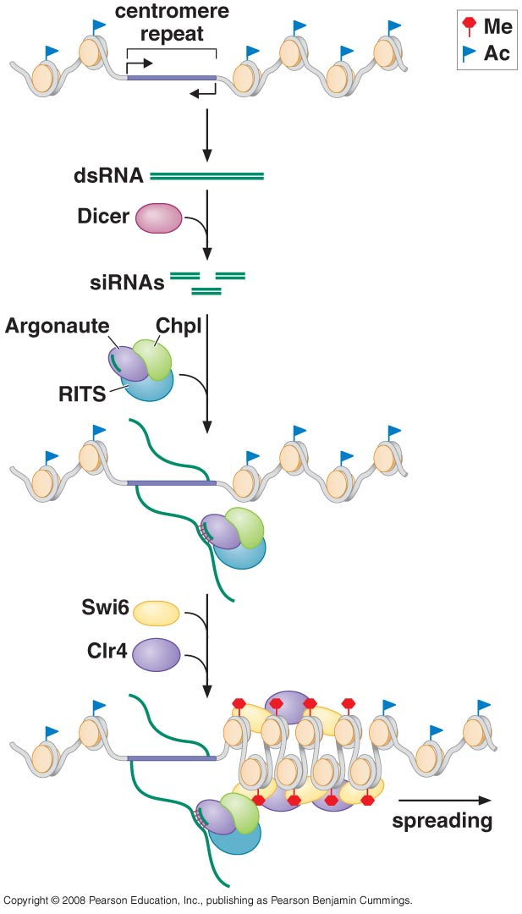
Small RNAs can transcriptionally silence genes by directing chromatin modification
RITS: RNA induced transcription silencing

Slide 19
THE EVOLUTION AND EXPLOITATION OF RNAi
Did RNAi evolve as an immune system?

Slide 20
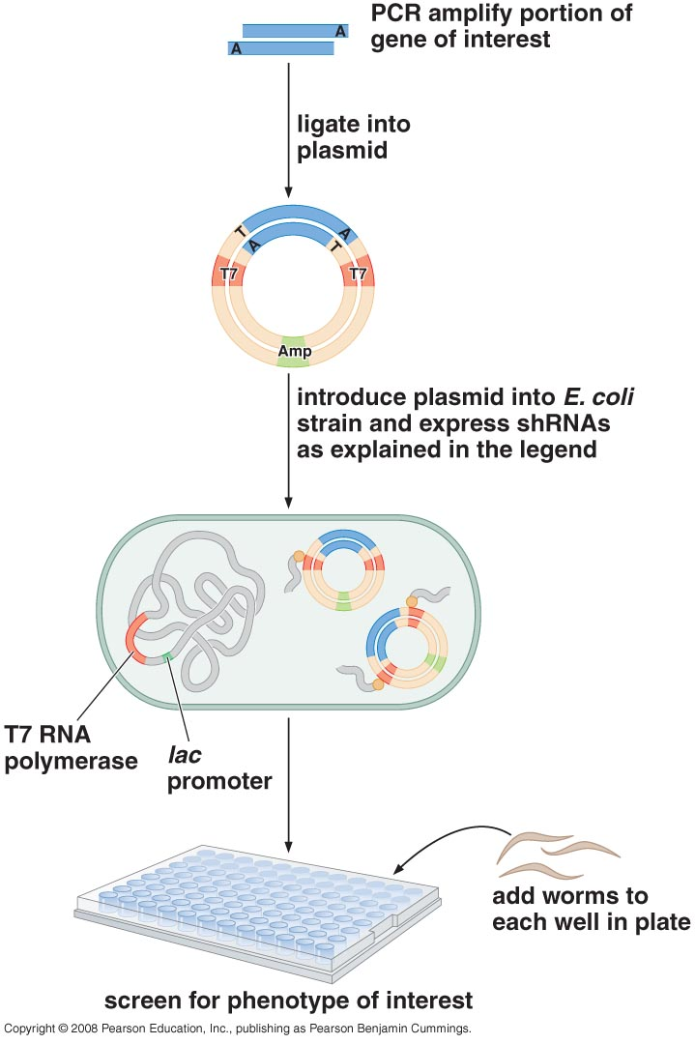
RNAi has become a powerful tool for manipulating gene expression
sh RNA: short hairpin RNA genes (like miRNA)

Slide 21
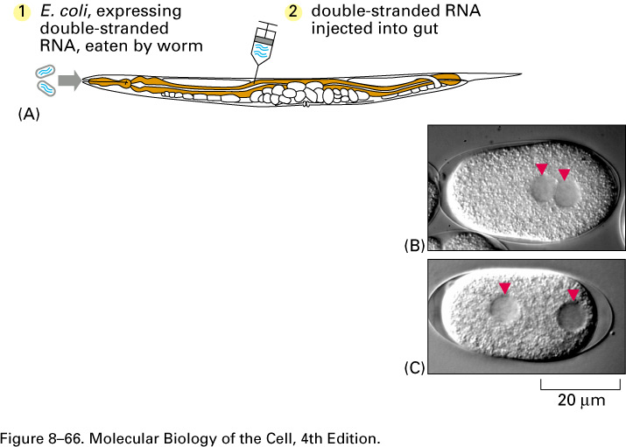
Dominant negative mutations created by RNA interference.
(A) Double-stranded RNA (dsRNA) can be introduced into C. elegans (1) by feeding the worms with E. coli expressing the dsRNA or (2) by injecting dsRNA directly into the gut. (B) Wild-type worm embryo. (C) Worm embryo in which a gene involved in cell division has been inactivated by RNAi. The embryo shows abnormal migration of the two unfused nuclei of the egg and sperm. (B, C, from P. Gönczy et al., Nature 408:331–336, 2000

Slide 22
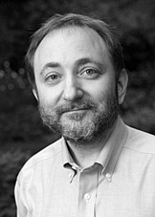
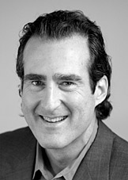
The Nobel Prize in Physiology or Medicine 2006
"for their discovery of RNA interference - gene silencing by double-stranded RNA"
Andrew Z. Fire | Craig C. Mello
1/2 of the prize | 1/2 of the prize
USA | USA
Stanford University School of Medicine Stanford, CA, USA | University of Massachusetts Medical School Worcester,

Slide 23
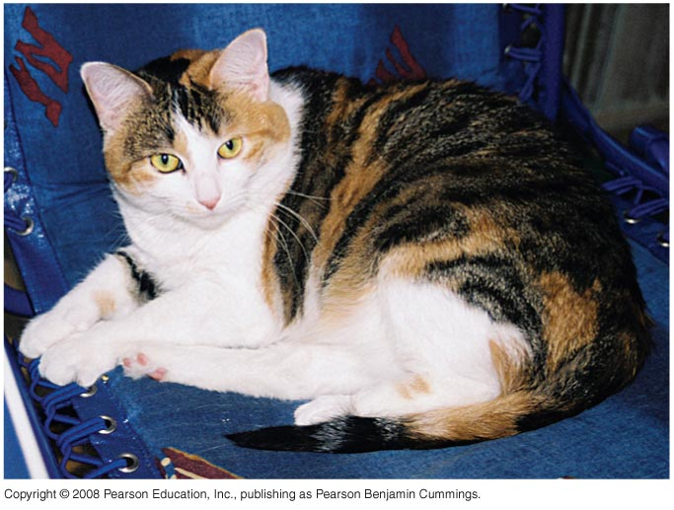
REGULATORY RNAS AND X-INACTIVATION
X-inactivation creates mosaic individuals

Slide 24
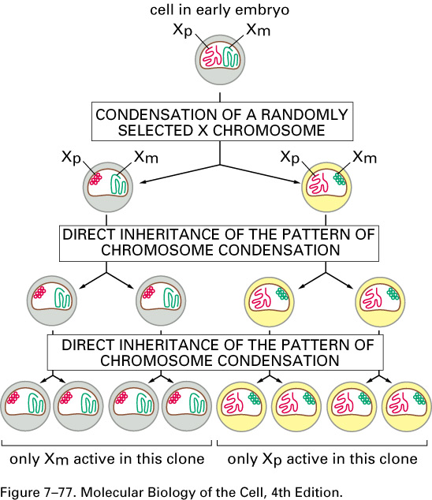
Chromosome wide alterations in chromatin structure can be inherited (dosage compensation)
X-inactivation

Slide 25
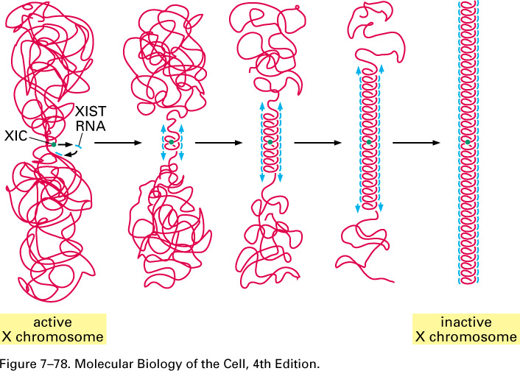
Xist is an RNA regulator that inactivates a single X chromosome in female mammals
Mammalian X-chromosome inactivation
XIST: X-inactivation
Specific transcript
XIC: x-inactivation
center

Slide 26
